Slide 1
Technological and business
V DHANUSH KUMAR
Astvu32124u18015
Bsc . Computer science
Muthurangam government arts college –thiruvalluvar University

Slide 2
Technological and business
“Technological” and “business” are intrinsically linked, with technology transforming how businesses operate, innovate, and compete by enabling automation, improving communication, enhancing efficiency, and unlocking new markets. This integration of technology leads to data-driven decisions, better customer service, and reduced operational costs, fundamentally changing business models and creating opportunities for growth and competitive advantage.

Slide 3
Agenda
1.Portfolio design and Layout
2.Tools and Technologies
3.Problem Statement
4.Features and Functionality
5.Project Overview
6.Results and Screenshots
7.Conclusion
8.Github Link

Slide 4
Problem statement
The problem statement you provided highlights the limitations of traditional resumes in today’s digital era, where a structured online presence is essential for students and professionals to effectively showcase their skills, projects, and achievements. Below, I’ll restate and analyze the problem statement, then connect it to the previously provided digital portfolio code as a solution.

Slide 5
PROJECT OVERVIEW
Adapts seamlessly to desktops, tablets, and mobile devices. Uses CSS Grid and media queries for a flexible, user-friendly layout.
Header: Displays the user’s name and tagline (e.g., “Technology Enthusiast & Business Professional”). Navigation: Sticky navbar with smooth scrolling to sections (About, Skills, Projects, Experience, Contact). About: A brief introduction highlighting the user’s background and expertise. Skills: A grid showcasing technical (e.g., HTML5, JavaScript, Python) and business skills (e.g., Business Analysis, Project Management).

Slide 6
Adapts to all devices (desktop, tablet, mobile) using CSS Grid and media queries. Ensures accessibility and a seamless user experience. Header: Displays the user’s name and tagline (e.g., “Technology Enthusiast & Business Professional”). Navigation: Sticky navbar with smooth scrolling to sections (About, Skills, Projects, Experience, Contact). About: Summarizes the user’s background, blending technical and business expertise. Skills: Grid of technical skills (e.g., HTML5, JavaScript, Python) and business skills (e.g., Business Analysis, Project Management).

Slide 7
Who are the end users?
The end users of the digital portfolio project are the individuals who interact with or benefit from the portfolio website, designed to address the limitations of traditional resumes by providing a structured, interactive online platform to showcase technological and business skills, projects, and achievements. Below is a concise identification of the end users, tailored to the problem statement and the provided portfolio code.

Slide 8
Tools and Techniques used
HTML: Purpose: Provides the semantic structure for the portfolio, ensuring accessibility and SEO-friendliness.
CSS: Purpose: Styles the portfolio for a modern, responsive, and visually appealing design.
Git/GitHub: Purpose: Track changes and host the portfolio online.

Slide 9
Portfolio design and Layout
Header: Full-width with a strong background color, the portfolio owner’s name large and prominent, with a subtitle describing the portfolio type. Navigation Bar: Center-aligned horizontal navigation with minimal links for smooth user experience allowing quick access to different portfolio sections. Sectioning: Each major section (Tech Projects, Business Projects, Skills, Contact) separated by generous white space, distinct background colors or subtle shadows to create card-like containers.

Slide 10
Features and functionality
Personal Branding: The header prominently displays the portfolio owner’s name and a subtitle describing the portfolio’s focus. Responsive Navigation Bar: A simple horizontal navigation bar allows users to quickly jump to sections like Tech Projects, Business Projects, Skills, and Contact. Project Showcases: Separate sections for technological and business projects with titles, descriptions, and links (e.g., to GitHub repositories). Skills Listing: Skills relevant to technology and business are listed clearly for quick scanning.

Slide 11
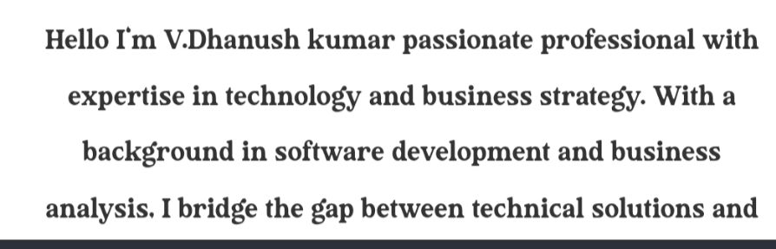
Result and screenshot

Slide 12
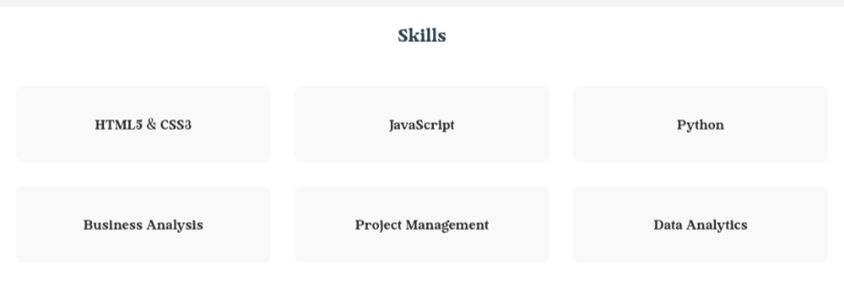
Result and screenshot

Slide 13
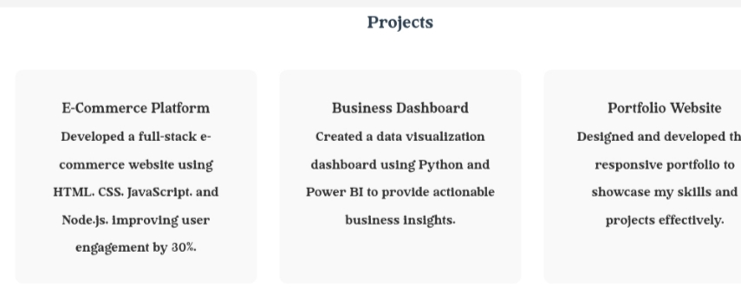
Result and screenshot

Slide 14
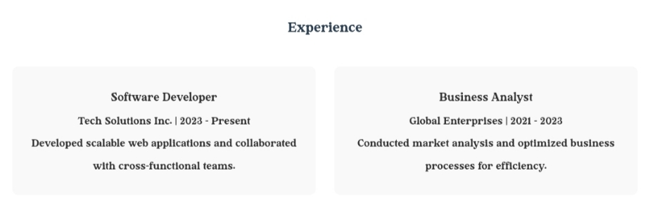
Result and screenshot

Slide 15
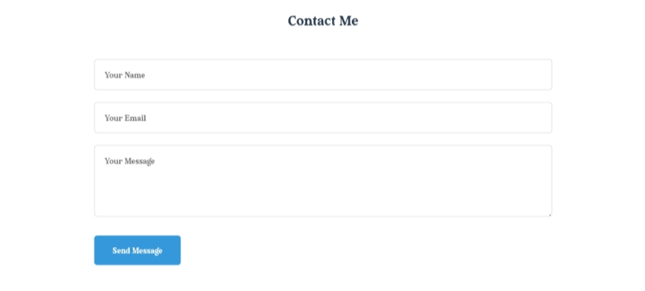
Result and screenshot

Slide 16
Conclusion
In the provided digital portfolio coding offers a solid foundation for showcasing technological and business skills effectively in today’s digital era. By combining clean HTML structure, professional CSS styling, and interactive JavaScript validation, this portfolio creates an accessible, user-friendly platform tailored to highlight projects, skills, and contact information in an engaging manner.

Slide 17
Thanking you

